Slide 1
NBA Project

Slide 2

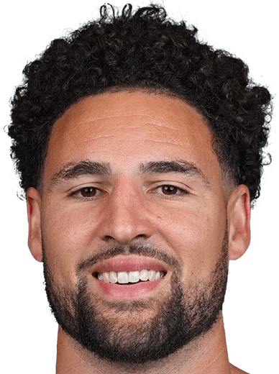

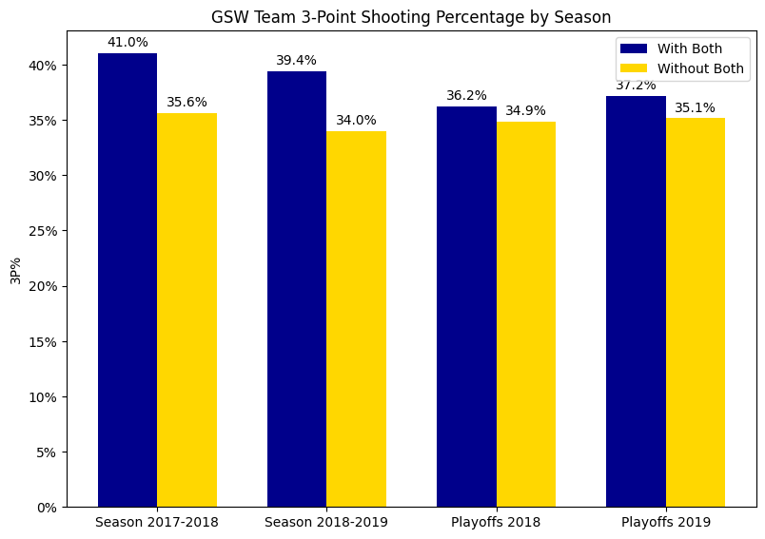
Part A: Golden State Warriors
‘Splash Brothers’ Analysis
Metric Description: 3P%
The 3-point shooting percentage (3P%) quantifies a team's accuracy from beyond the arc, a metric directly relevant to evaluating the impact of "power partnerships" like Curry and Thompson on GSW's offensive efficiency.
Methodology
We calculated and compared GSW's 3P% in scenarios with and without at least one member of the elite Curry-Thompson partnership to provide insights into the strategic impact of star player combinations.
Takeaways
GSW's overall 3P% notably peaks when Curry and Thompson play together, suggesting they ideally should share the court to maximize effectiveness. This was exemplified in the 2017-2018 season, where their highest 3P% with the duo contributed to winning the NBA title.

Slide 3


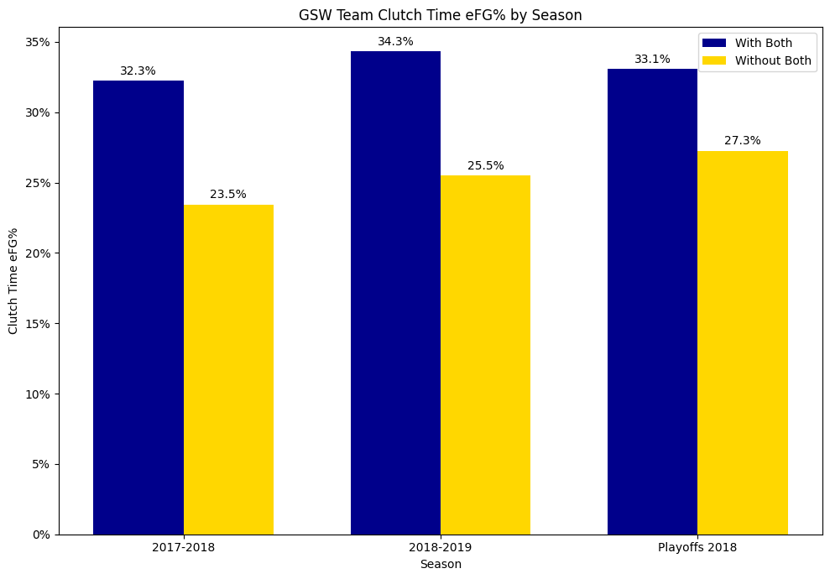
Part A: Golden State Warriors
‘Splash Brothers’ Analysis
Metric Description: Clutch Time eFG%
Clutch Time eFG% measures shooting efficiency during the final 5 minutes of a game with a score difference of 5 or less, factoring in the added value of three-point field goals with the formula:
(FG + 0.5 * 3P) / FGA
Methodology
We compared GSW's Clutch Time eFG% by Season for 2017-2018, 2018-2019, and the 2018 Playoffs, with and without at least one member of the Curry-Thompson partnership. The 2019 Playoffs were excluded as the duo played together in all games.
Takeaways
The bar chart indicates a significantly higher Clutch Time eFG% when Curry and Thompson play together, once again emphasizing their critical impact and synergy during the game's most critical moments.

Slide 4


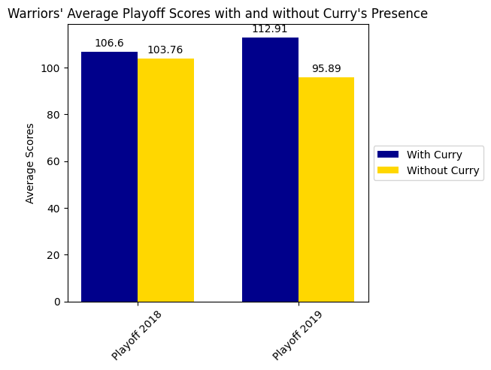
Part B: Impact Analysis
Stephen Curry
Metric: Average Game Scores
We analyzed the average points scored by GSW in games with and without Stephen Curry, showcasing a substantial scoring influence attributable to Curry, which directly aligns with the hypothesis that a star player elevates team performance.
Methodology
Our methodology focused on comparing avg game scores during playoff seasons with and without Curry's presence. We specifically isolated playoff performance due to its high-stakes nature, where the impact of a star player is often most pronounced and critical to the team's success.
Takeaways
The data indicates that GSW scores significantly higher on average when Curry is on the court, with a particularly stark difference observed in the 2019 playoffs, supporting the hypothesis that great players, like Curry, can elevate their team's offensive game, as suggested by the prompt.

